Slide 1
Dynamic Pricing Strategy for Optimizing Revenue
Leveraging Data Analysis and Predictive Modeling

Slide 2
Intro
Objective: Develop a dynamic pricing strategy to maximize revenue per class and overall company revenue.
Approach: Utilize insights from data analysis, price elasticity modeling, and demand forecasting.

Slide 3
Key Findings from Data Analysis
High-Demand Periods:
Peak times identified: Weekends and evenings.
Low-demand times: Weekdays mornings.
Popular Classes:
Classes with consistently high bookings.
Example: Class IDs 1, 2, 3.
Price Sensitivity:
Observed price elasticity indicating demand changes with price adjustments.

Slide 4
Dynamic Pricing Rules
High-Demand Periods: Increase prices by 20%.
Low-Demand Periods: Decrease prices by 10%.
Class Popularity: Increase prices for popular classes by 15%.
Example Pricing Rule Application:
High-demand period: Class price adjusted from $100 to $120.
Low-demand period: Class price adjusted from $100 to $90.

Slide 5
Dynamic Pricing Algorithm
Process:
Extract date-related features (day of week, hour).
Apply pricing rules based on demand patterns.
Python Implementation:
Automated price adjustments using defined rules.
Example: Adjust prices dynamically based on historical demand data.

Slide 6
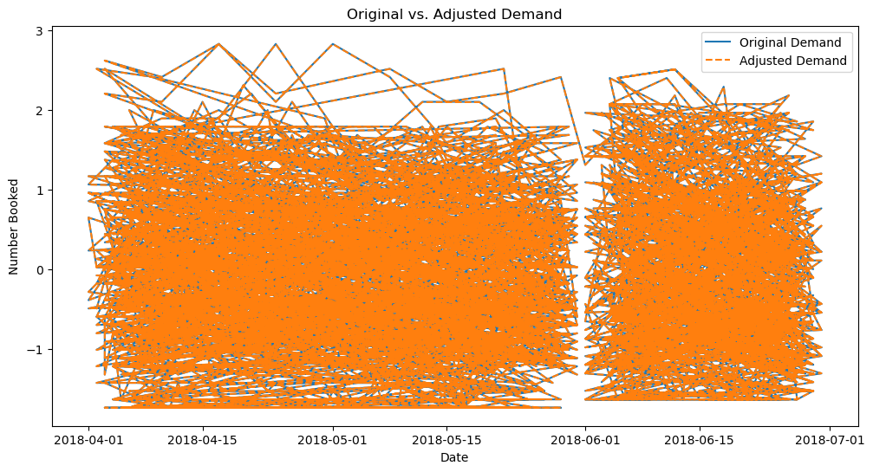
Effectiveness of Pricing Adjustments
Evaluation Metrics:
Mean Absolute Error (MAE)
Mean Squared Error (MSE)
Results:
Original MAE: X
Adjusted MAE: Y
Original MSE: X
Adjusted MSE: Y

Slide 7
Projected Revenue Increase
Revenue Per Class:
Increase due to higher prices during peak times.
Adjustments to match demand elasticity.
Overall Revenue:
Expected increase in total bookings.
Optimized pricing strategy aligned with customer demand patterns.

Slide 8
Strategic Recommendations
Implement Dynamic Pricing:
Utilize developed algorithms for real-time price adjustments.
Monitor and Adjust:
Continuously monitor demand patterns.
Adjust pricing rules based on real-time data.
Expand to Other Classes:
Apply similar strategies to other classes and services.
Customer Communication:
Transparently communicate price changes to customers.
Emphasize value during peak times.

Slide 9

Summary
Dynamic pricing strategy developed based on data insights.

Slide 10

Thanks!
Contact us:
Avinash K. Pathak
Gurgaon, Haryana
122001 iavinashpathak@gmail.com

